Slide 1
Duke Fishron Overview
- Duke Fishron is a powerful boss in Terraria, known for its unique design and challenging mechanics.
- It is summoned by using a Fishron in the Ocean biome during a Hardmode phase.
- Players must be well-prepared to face this formidable foe.

Slide 2
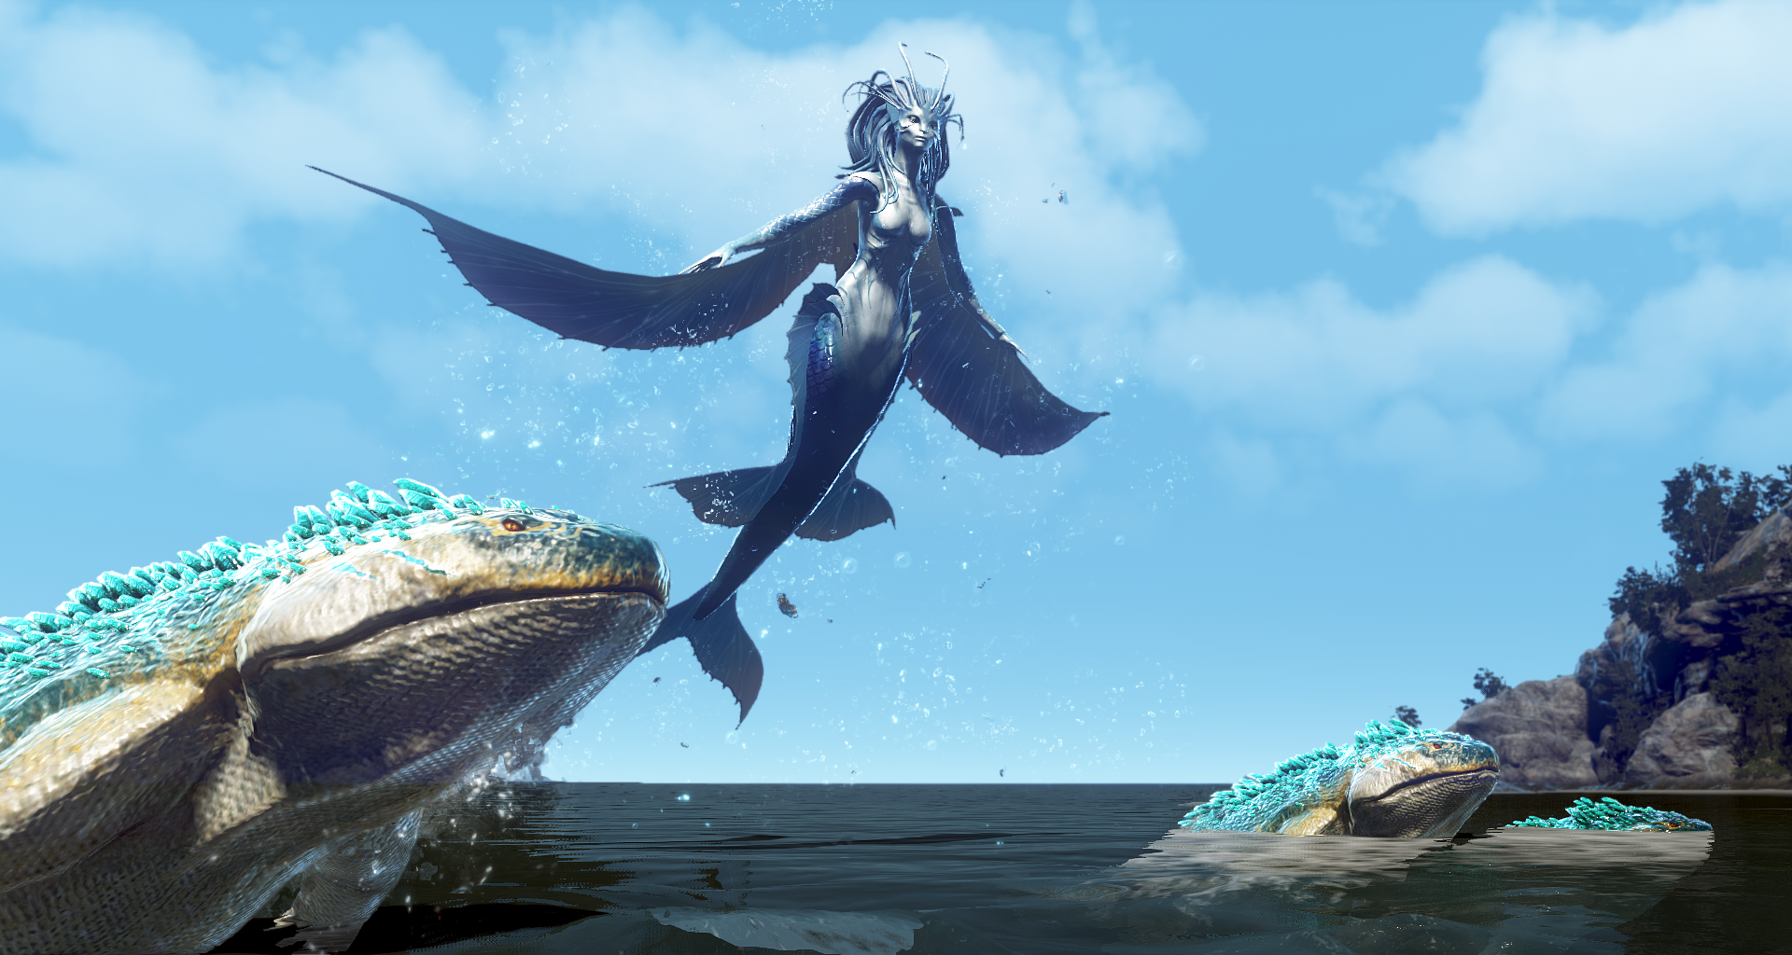
Summoning Duke Fishron
- To summon Duke Fishron, players must fish in the Ocean biome using a Truffle Worm.
- The boss appears after a short delay and can be fought in the water.
- Players should ensure they have adequate health and potions before attempting the summon.

Slide 3

Battle Mechanics
- Duke Fishron has several attack patterns, including charging at players and creating tornadoes.
- It can also summon smaller fish minions to assist in the fight.
- Players need to dodge its attacks while dealing damage to defeat it.

Slide 4

Drops and Rewards
- Upon defeat, Duke Fishron drops valuable items, including the Fishron Wings and the Bubble Gun.
- Players can also obtain a variety of fishing-related items and materials.
- These rewards are highly sought after for their utility in gameplay.

Slide 5
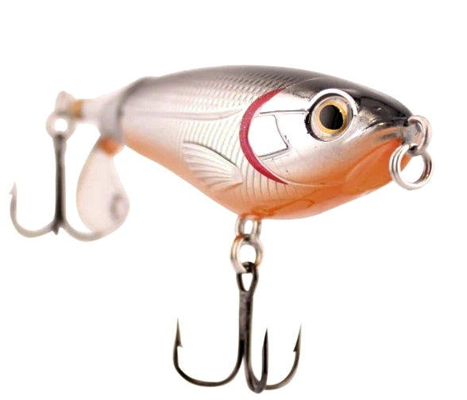
Strategies for Defeating Duke Fishron
- Utilize mobility accessories to dodge Duke Fishron's attacks effectively.
- Ranged weapons are recommended for keeping distance while dealing damage.
- Prepare potions and buffs to enhance survivability during the fight.

